Slide 1


Mathematics of Getting into Orbit
Presentation By Jacob Sorensen

Slide 2
Video Links
https://youtu.be/5EwW8ZkArL4?t=12600
https://youtu.be/TN25ghkfgQA

Slide 3

What is Max Q?
Max Q is the maximum dynamic pressure experienced by a rocket during flight
The equation for dynamic pressure is
At the start of a rocket launch v = 0, so q is 0
In space the density of air is 0, so q is 0
Therefore, since q is non-negative, there must be a maximum

Slide 4
This specific Launch
Pulling telemetry values from the video gives altitude and velocity curves as follows:

Slide 5
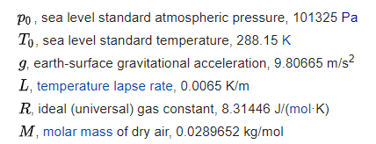
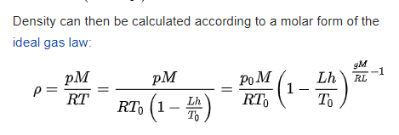
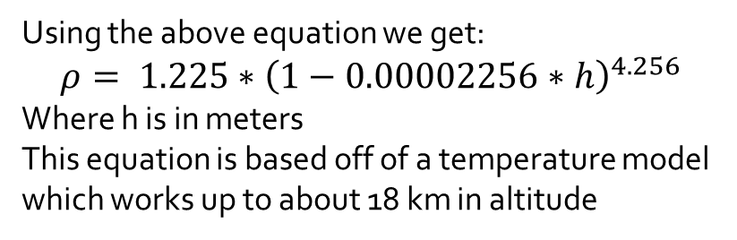
Estimating Air Density
Using the above equation we get:
$$ρ= 1.225∗{\left(1−0.00002256∗h\right)}^{4.256}$$
Where h is in meters
This equation is based off of a temperature model which works up to about 18 km in altitude

Slide 7
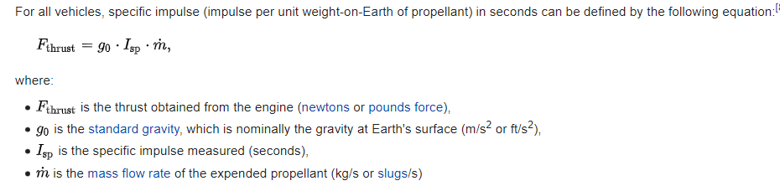
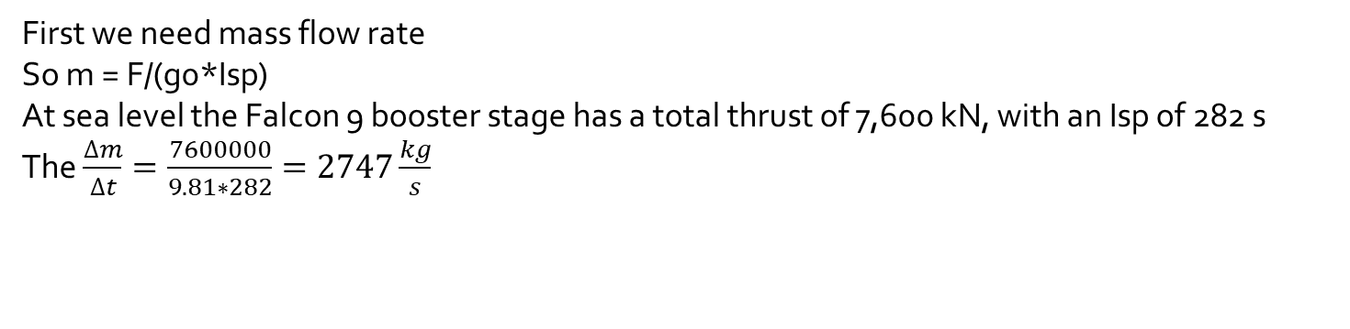
Lets do one ourselves!
First we need mass flow rate
So m = F/(g0*Isp)
At sea level the Falcon 9 booster stage has a total thrust of 7,600 kN, with an Isp of 282 s
The $\frac{∆m}{∆t}=\frac{7600000}{9.81∗282}=2747\frac{kg}{s}$

Slide 8
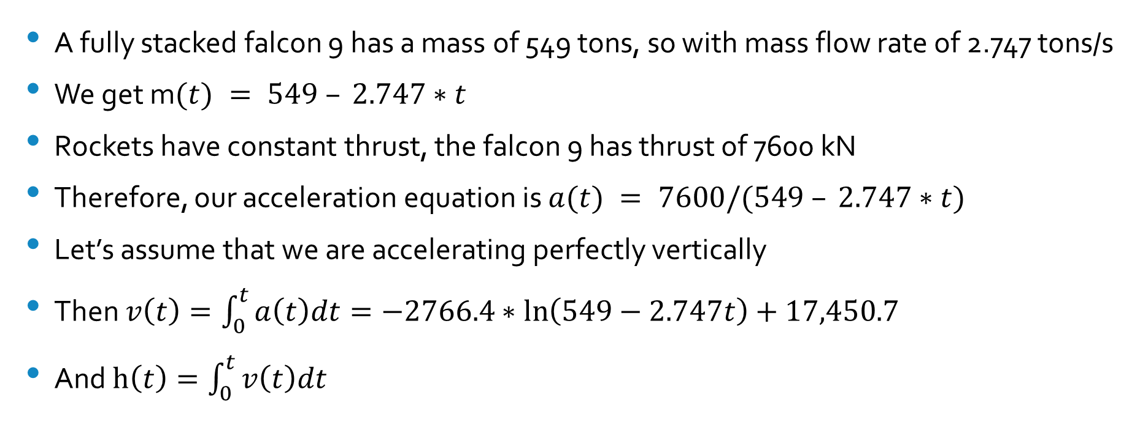
F = ma, therefore a = F/m
A fully stacked falcon 9 has a mass of 549 tons, so with mass flow rate of 2.747 tons/s
We get m$(t) = 549 – 2.747∗t$
Rockets have constant thrust, the falcon 9 has thrust of 7600 kN
Therefore, our acceleration equation is $a(t) = 7600/(549 – 2.747∗t)$
Let’s assume that we are accelerating perfectly vertically
Then $v\left(t\right)=\int_{0}^{t}{a\left(t\right)dt}=−2766.4∗\ln\left(549−2.747t\right)+17,450.7$
And $h\left(t\right)=\int_{0}^{t}{v\left(t\right)dt}$

Slide 9
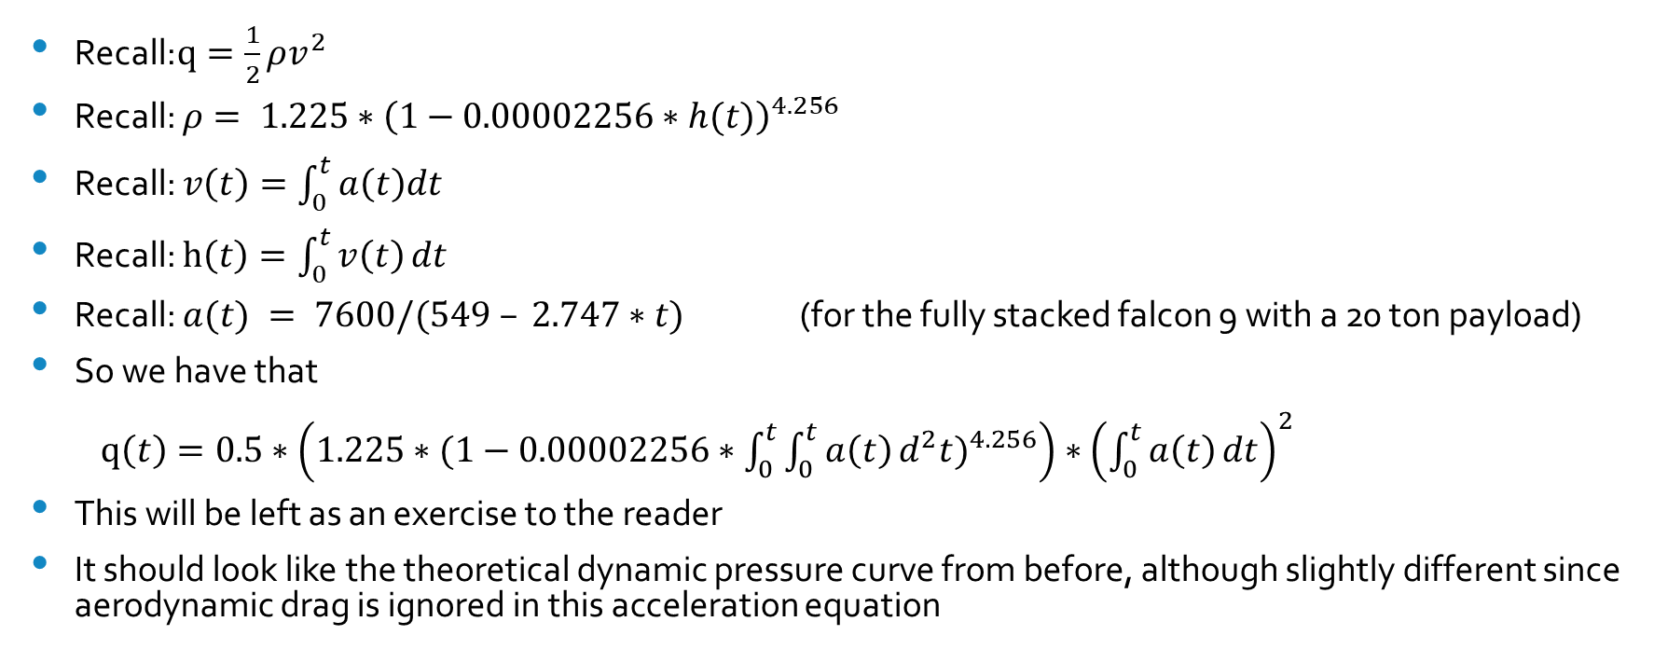
Now solve for dynamic pressure q
Recall:$q=\frac{1}{2}{ρv}^{2}$
Recall: $ρ= 1.225∗{\left(1−0.00002256∗h(t)\right)}^{4.256}$
Recall: $v\left(t\right)=\int_{0}^{t}{a\left(t\right)dt}$
Recall: $h\left(t\right)=\int_{0}^{t}{v\left(t\right)}dt$
Recall: $a(t) = 7600/(549 – 2.747∗t)$ (for the fully stacked falcon 9 with a 20 ton payload)
So we have that
$q\left(t\right)={0.5∗\left(1.225∗{(1−0.00002256∗\int_{0}^{t}{\int_{0}^{t}{a\left(t\right)}d^{2}t})}^{4.256}\right)∗\left(\int_{0}^{t}{a\left(t\right)}dt\right)}^{2}$
This will be left as an exercise to the reader
It should look like the theoretical dynamic pressure curve from before, although slightly different since aerodynamic drag is ignored in this acceleration equation

Slide 10
Why use two stages?
Several Factors:
Simple Delta V calculation
Vacuum optimized engines vs sea level optimized engines

Slide 11
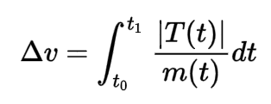


Dry Mass Reduction
The falcon 9 booster:
Dry Mass ($m_{d}$): 22 tons
Fuel Mass ($m_{f}$): 400 tons
The falcon 9 second stage:
Dry Mass ($m_{d}$): 4 tons
Fuel Mass ($m_{f}$): 100 tons
+ ~ 20 ton payload ($m_{p}$)
Recall:
Let $R_{c}=rate of fuel consumption in kg/s$
Recall: $F_{g}=9.81m/s^2$
Recall: $F\left(t\right)=R_{c}∗I_{SP} ∗F_{g}$
Recall: $m\left(t\right)=m_{f}+m_{d}+m_{p}−R_{c}∗t$
Recall: $t_{0}=0$ and $t_{1}=m_{f}/R_{c}$
Suppose both stages have an $I_{SP}$ of 300 seconds
Consider that the second stage will be fully fueled when deployed

Slide 12
Engine Optimization
Remember how I said “Suppose both stages have an ISP of 300 seconds”?
This is not the case. Specific Impulse depends on the engine, and what pressure it is optimized for.
Everyday Astronaut explains it well: https://youtu.be/D4SaofKCYwo?t=502
The Falcon 9 booster stage ISP’s are 282 seconds at sea level, and 311 s in vacuum
The Falcon 9 second stage has an ISP of 348 seconds in vacuum
Lets do the same calculation as before, but with this new information

